Slide 1


INTRODUCTON
Topic : Travel Portal for
Sri Lankan Tourist Board
OUR GROUP CONSISTS OF
DIT/11/C2/0345 Jayarathne R.P.E.T.
DIT/11/C2/0288 Kalupahana S.I.G.
DIT/11/C2/0300 Nanayakkara D.C.
DIT/11/C2/0328 Kirinda G.L.M.
DIT/11/C2/0343 Piumika W.M.S.
DIT/11/C2/0353 Thilantha B.Y.
DIT/11/C2/0357 Chathuranga A.W.I.

Slide 2
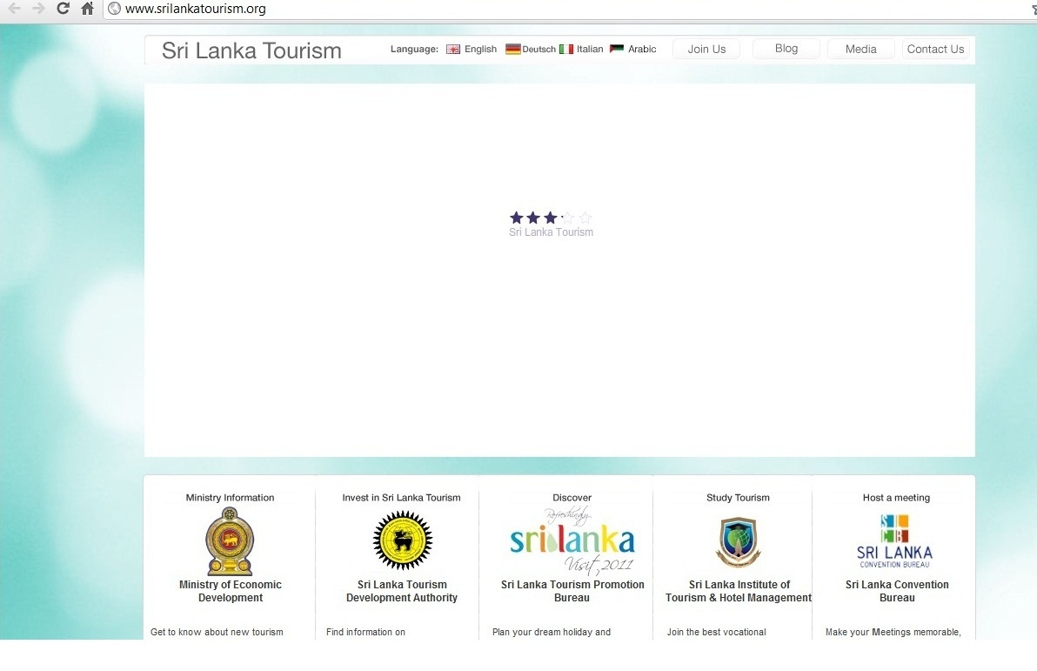
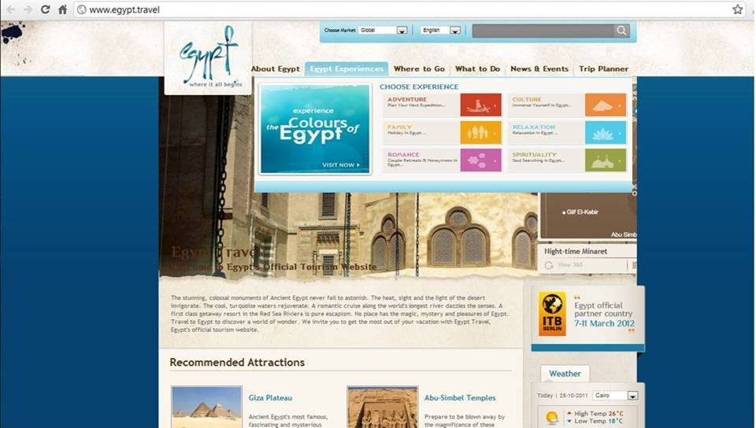
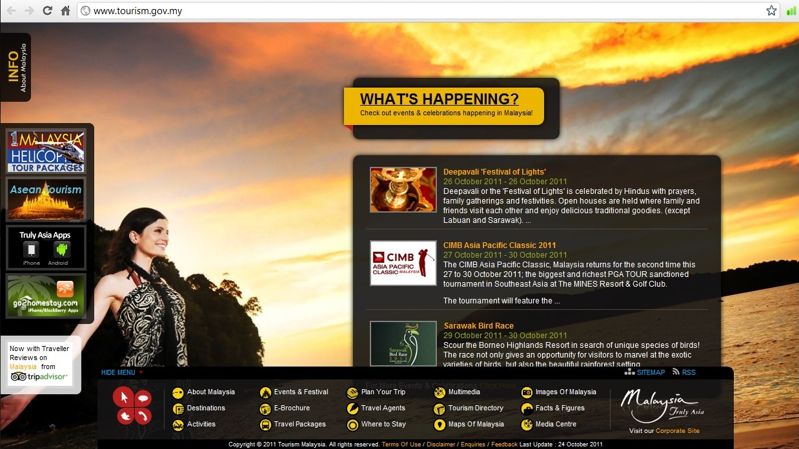
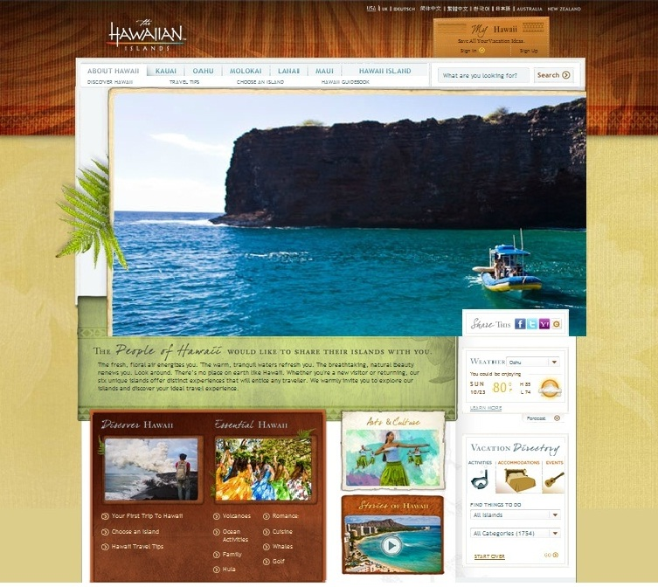
CURRENT WEBSITE
PROBLEMS IN THE CURRENT WEBSITE
Not user friendly
Not eye catching
Post war era is not highlighted
Website is not directly linked with other services
Transport services
Travel guide services
Hotels & reservations
Airline services
Not optimized

Slide 3
Proposed Website
User friendly & properly guided
Eye catching
Post war era is highlight
Directly linked with ,
transport services
hotels reservation
airline services
Booking facilities
Travel guide
  Maps
  Routes
  Weather forecast
  SE optimization

Slide 4
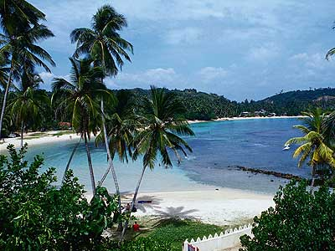

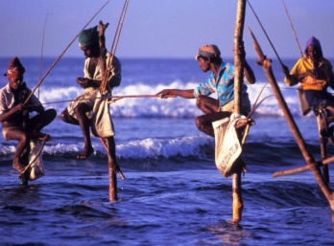





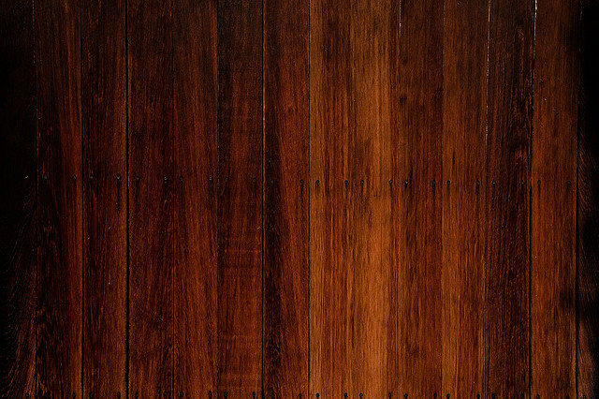
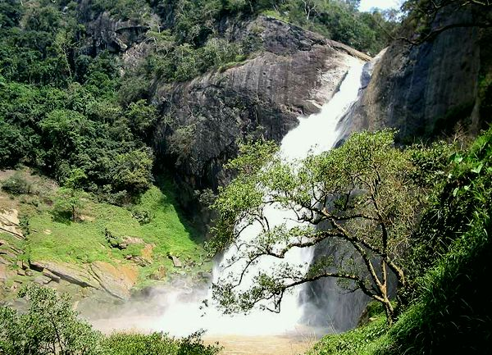
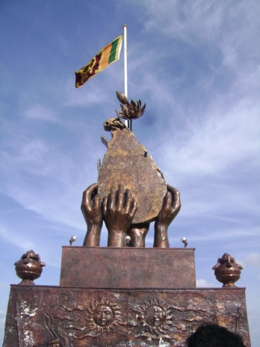
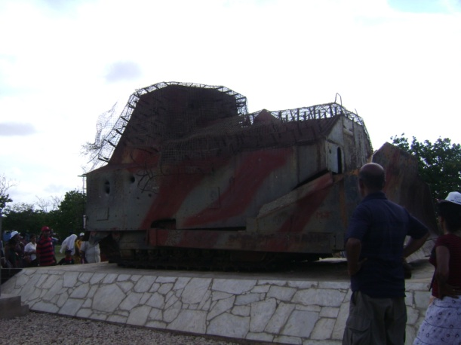
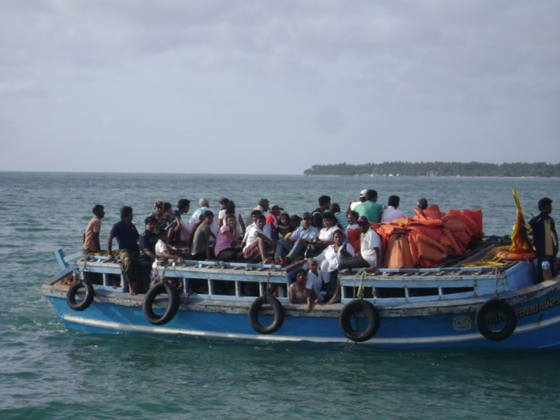
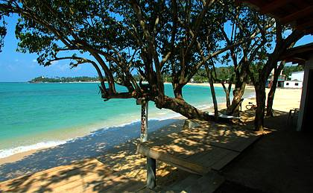
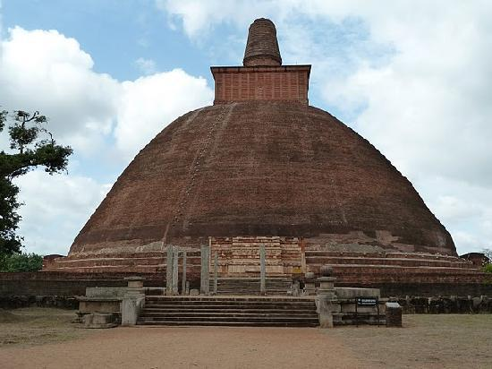
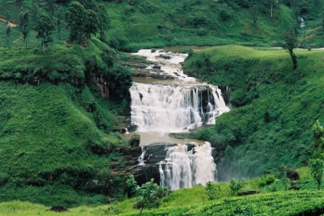
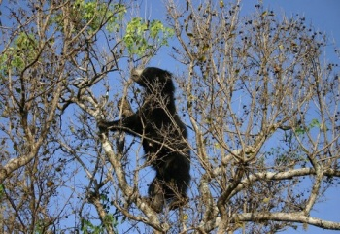
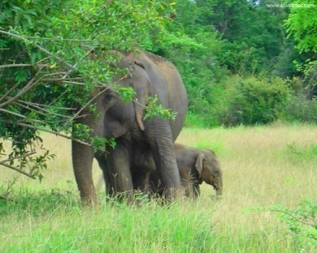
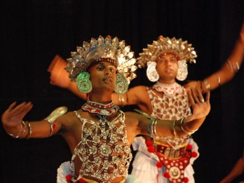
SRI LANKA TOURIST BOARD
Proposed Website
HOME
POST WAR ERA
HOME
POST WAR ERA
TRAVEL GUIDE
HOTELS
TRANSPORT
What would you do here..?
Tour Historical Places
This beautiful ancient land is blessed with a slew of sites, which have immense historical and archaeological significance.
Hoteliers big and small in Sri Lanka are getting ready to cash in on what they say is the inevitable boom around the corner after last month's end to the nation's bloody quarter-century-old civil conflict. Tourism in this tropical-island nation was one of the industries hit hardest by the war between government forces and the Liberation Tigers of Tamil Eelam (LTTE). From the white-sand beaches of Hikkaduwa to the verdant mountains of Kandy, the tourism industry has endured a 25-year-old yo-yo ride with profits fluctuating from year to year with the state of the conflict.
Tour Nature
Paradise is perhaps the best word to describe Sri Lanka, a serene, tropical island of golden beaches and blue waters. Famed for the amazing diversity of culture, the natural beauty of the landscape and a complex history dating back to 543 BC, this country is truly amazing. Coastal beaches merging into jungle and the hill country with peaks reaching a height of 2524 meters.
Nature rules in this part of the world enjoys a privileged setting from which to observe some rare marvels: protected elephant herds in national parks, monkeys in paradise and tropical birdlife; as well as walks around local villages exhibiting the simple pleasures of island life..
More…..

Slide 5
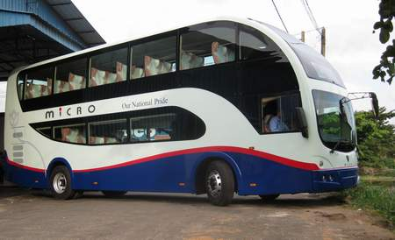
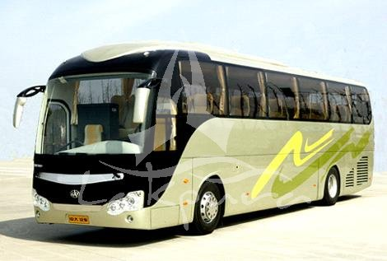
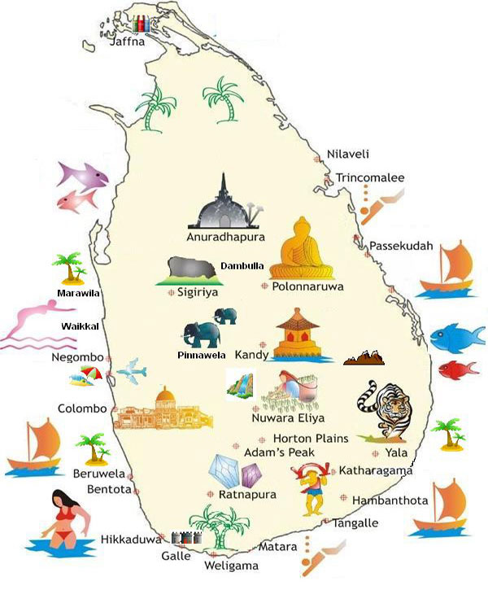
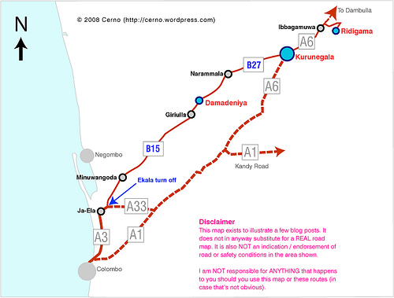
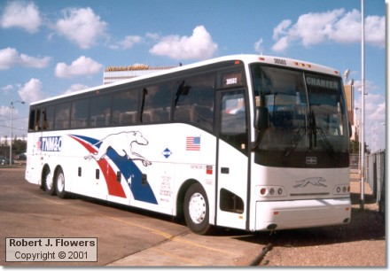
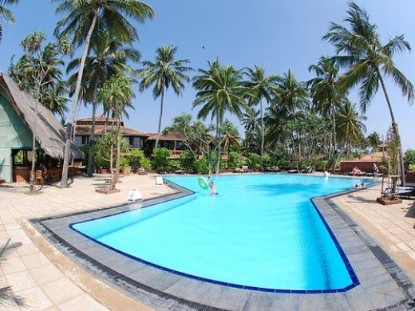
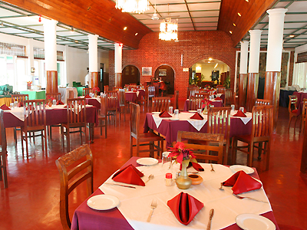
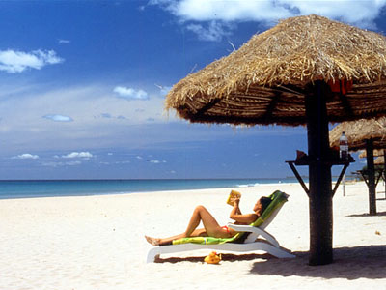
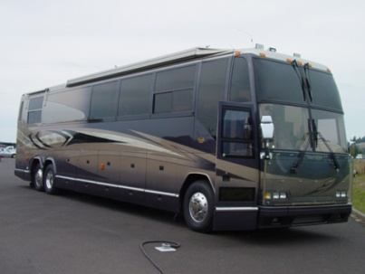
SRI LANKA TOURIST BOARD
POST WAR ERA
TRAVEL GUIDE
TRAVEL GUIDE
TRANSPORT
HOME
HOTELS
TRANSPORT
HOTELS
Best Transport services in Sri Lanka
Best Tourist Hotels in Sri Lanka
Travelling Maps
Touring routs
Colombo
Jetwin Travels
NVLS Tours
JNW Lanka Tours
ACV Travels & conventions
Classic travels (PVT) Ltd.
Aseantica Tours & Services
More…
Hill Country
Hotel Galadhari
Taj Samudra Hotel
Hotel Cinnamon Grand
Queens Hotel
Earl Regency Hotel
Kithulgala Rest House
Southern
More Hotels…
Hikkaduva beach Hotel
Light House Hotel
Hotel Heritance
Choose Best Path for your Journey

Slide 6

Advantages
  Increases number of tourists
  Hotels ,Transport services can be advertised
  The tourist board can earn a profit by adverts
  Can make a better image about the current situation in Sri Lanka
  Prospective tourist can get their work done easily in a short time
  Helps to increase the economic development in Sri Lanka

